Slide 1
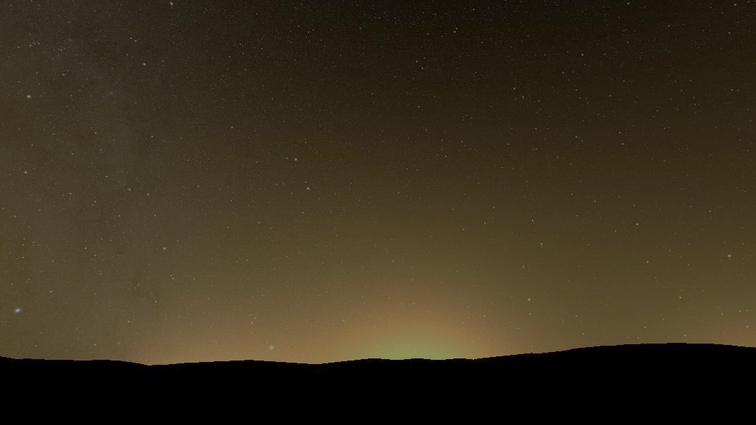
Efficient Visualization of Light Pollution for the Night Sky
Yoshinori Dobashi^{1,3} Naoto Ishikawa¹ Kei Iwasaki^{2,3}
¹Hokkaido Univ. ²Saitama Univ. ³Prometech CG Research
Notes:
Thank you for the introduction. I would like to talk about efficient visualization of light pollution for the night sky. I'm Yoshinori Dobashi from Hokkaido University and working for prometech cg research laboratory in Japan.

Slide 2
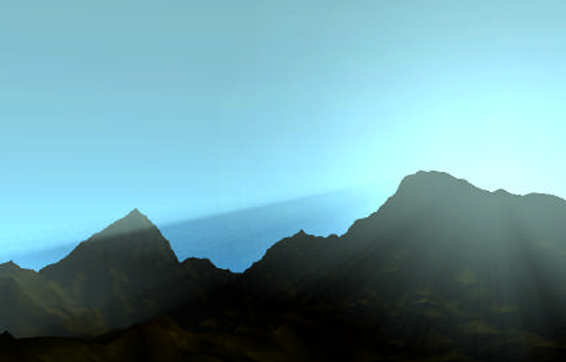
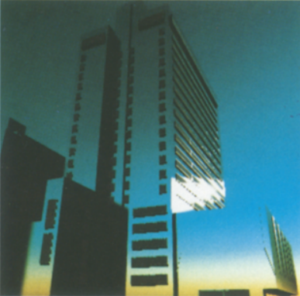
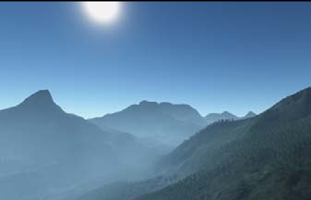
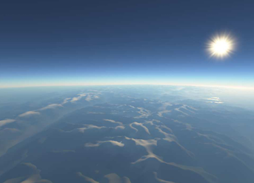
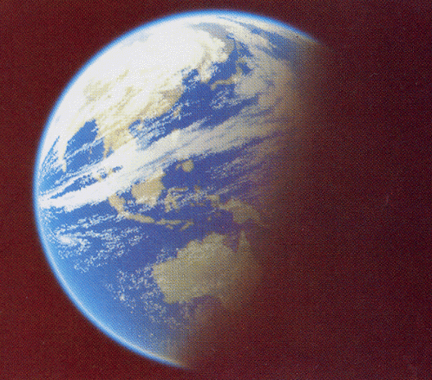
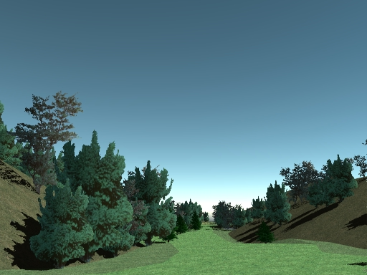
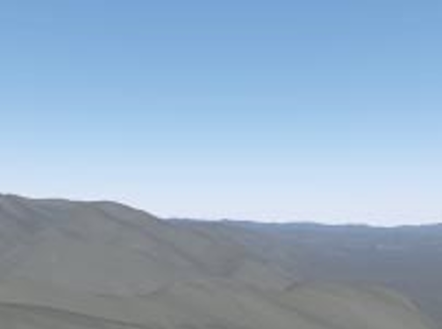
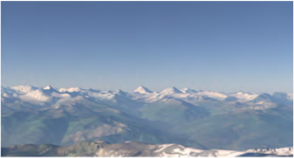
Rendering of the Sky
R. V. Klassen, Modeling the effect of the atmosphere on light. ACM Transactions on Graphics 6, 3 (1987), 215–237.
Kaneda et al., Photorealistic Image Synthesis for Outdoor Scenery under Various Atmospheric Conditions. The Visual Computer 7, 5-6 (1991), 247–258.
Nishita et al., Display of the Earth Taking into Account Atmospheric Scattering. In Proceedings of ACM SIGGRAPH 1993. 175–182.
Dobashi et al., Fast Display Method of Sky Color Using Basis Functions, Proc. Pacific Graphics'95, pp. 194-208.
Preetham et al., A Practical Analytic Model for Daylight. Proc. SIGGRAPH 1999, 91–100.
Dobashi et al. Interactive rendering of atmospheric scattering effects using graphics hardware. Proc. Graphics Hardware. 99 – 108.
Carsten Wenzel, Real time atmospheric effects in games revisited. In Game Developers Conference, 2007.
Bruneton and Neyret, Precomputed Atmospheric Scattering. Computer Graphics Forum 27, 4 (2008), 1079–1086.
Hosek and Wilkie, An Analytic Model for Full Spectral Sky Dome Radiance. ACM Trans. Graph. 31, 4, Article 95 (2012).
Wilkie et al., A Fitted Radiance and Attenuation Model for Realistic Atmospheres. ACM Trans. Graph. 40, 4, Article 135 (2021).
Notes:
Let me first talk about the rendering of the sky. The rendering of the sky is one of the important research topics in computer graphics and it has a long history. Many methods have been developed so far, such as the ones shown in the slide. Thanks to these methods, we can create realistic images of the sky as shown in the background of this slide.

Slide 3
Rendering of the Sky
Notes:
These methods allow us to create the beautiful sky at the sunset time as well as shown in this slide.

Slide 4
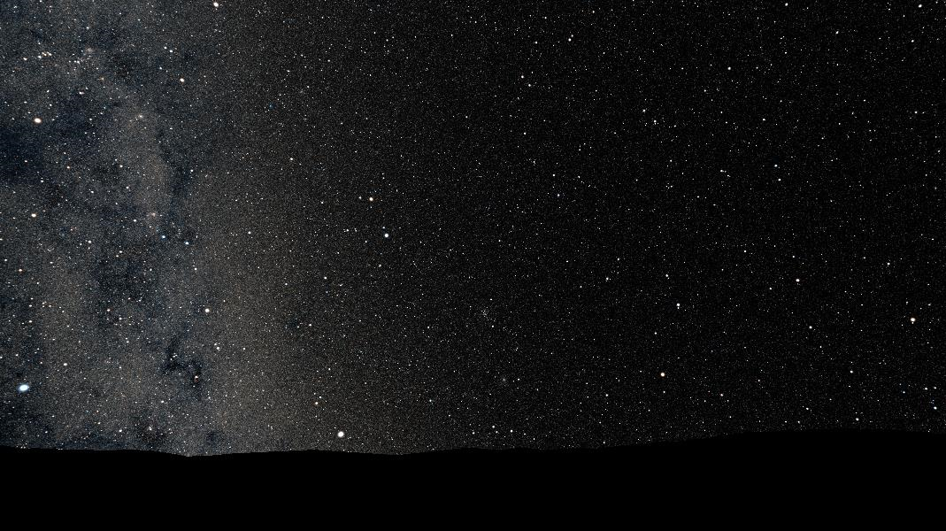
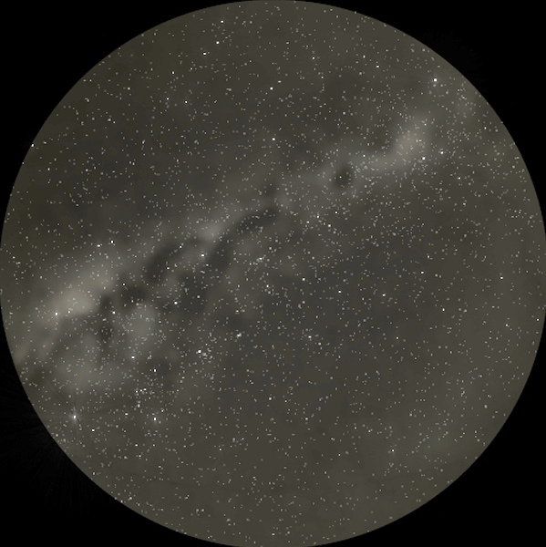
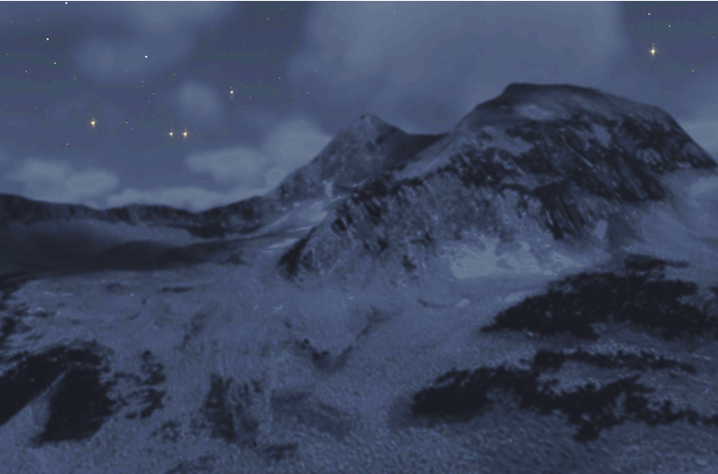
Rendering of the Night Sky
Jensen et al. , A Physically Based Night Sky Model. Proc. SIGGRAPH 2001), 399–408.
Notes:
Our research is on the rendering of the night sky. Different from the familiar daytime sky, the sky at night exhibits a different appearance. We can see the beautiful stars as shown in this image. In computer graphics, the first paper on the rendering of the night sky was published by Jensen et al. in 2001. This method can render the realistic images of the night sky taking into account the atmospheric scattering of light.

Slide 5
Rendering of the Night Sky
Jensen et al. , A Physically Based Night Sky Model. Proc. SIGGRAPH 2001), 399–408.
Notes:
Our research is on the rendering of the night sky. Different from the familiar daytime sky, the sky at night exhibits a different appearance. We can see the beautiful stars as shown in this image. In computer graphics, the first paper on the rendering of the night sky was published by Jensen et al. in 2001. This method can render the realistic images of the night sky taking into account the atmospheric scattering of light.

Slide 6
Light Pollution for the Night Sky
Notes:
We are also interested in the night sky, but we focus on a different aspect, that is, light pollution. All the methods developed so far in computer graphics assume that the light sources are outside of the earth, that is, the sun, the moon, or the stars. However, there are light sources on the ground, that is, …

Slide 7
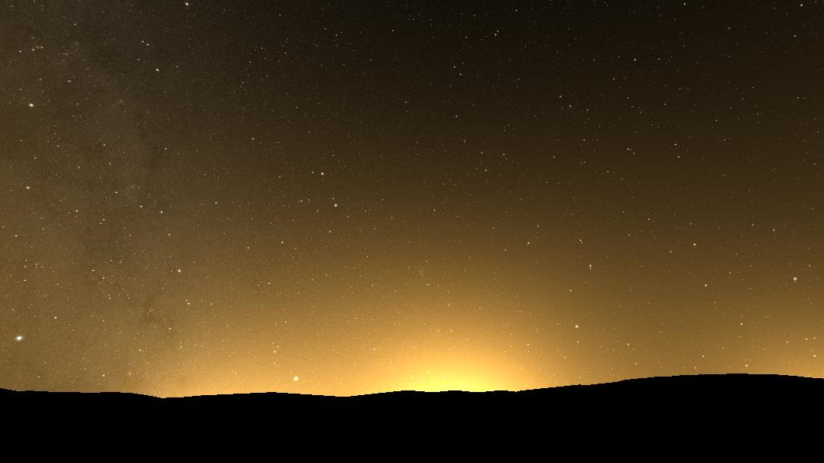
Light Pollution for the Night Sky
Minor et al., Skyglow: Towards a Night-time Illumination Model for Urban Environments. In EG 2016 – Posters.
Kocifaj, Multiple scattering contribution to the diffuse light of a night sky: A model which embraces all orders of scattering. Journal of Quantitative Spectroscopy and Radiative Transfer 206 (2018).
Bará et al., Fast Fourier transform calculation of artificial night sky brightness maps. Journal of Quantitative Spectroscopy and Radiative Transfer 240 (2020).
Falchi and Bará, Computing light pollution indicators for environmental assessment. Natural Sciences 1, 2 (2021).
Simoneau et al., Point spread functions for mapping artificial night sky luminance over large territories. Monthly Notices of the Royal Astronomical Society 504, 1 (2021).
Garstang, Model for Artificial Night-Sky Illumination. Publications of the Astronomical Society of the Pacific 98 (1986).
Kocifaj, Light-Pollution Model for Cloudy and Cloudless Night Skies with Ground-Based Light Sources. Applied optics (2007).
Bará et al, Modal evaluation of the anthropogenic night sky brightness at arbitrary distances from a light source. Journal of Optics 17, 10 (2015).
Kocifaj and Kundracik, Modeling the Night Sky Brightness Distribution via New SkyGlow Simulator. In 2016 IEEE Lighting Conference of the Visegrad Countries (Lumen V4) (2016).
Fast Rendering of Skyglow by City Light
city light
city light
city light
Notes:
City light sources. The city light sources cause the light pollution. The light from the city is scattered by the atmospheric particles, resulting in the skyglow as shown here. This skyglow makes us difficult to enjoy the beauty of the night sky. This is called the light pollution. Research on the light pollution has a long history and there are a significant number of papers published, as shown in the slide. However, none of these methods achieves the real-time rendering of the skyglow that allows us the interactive investigation of the light pollution. So, our goal is the fast rendering of the skyglow caused by city light sources.

Slide 8
GOAL
Fast Rendering of Skyglow by City Light
city light
city light
city light
Notes:
So, our goal is the fast rendering of the skyglow caused by city light sources.

Slide 9
CHALLENGE
Computation of light scattering due to numerous light sources
city light
city light
city light
Notes:
The challenge to achieve this goal is the long computation of the light scattering due to numerous light sources. For every point on every viewing ray, we have to accumulate the intensity of scattered light by many light sources. We developed a method that achieves three-orders of magnitude faster computation with a precomputation-based approach.

Slide 10
Overview
terrain map (height field)
Notes:
OK, now let me talk about an overview of our system. Our system takes a height field representing a terrain as input as shown on the left.

Slide 11
Overview
light source density
fast rendering
observer
terrain map (height field)
pseudo color
Notes:
We also need a density distribution of light sources representing the energy of light emitted from each location. The light energy is proportional to the density. Then, when a location of an observer is specified, our method computes the skyglow distribution over the whole sky instantaneously and visualizes the result as shown on the right.

Slide 12
Overview
light source density
fast rendering
observer
terrain map (height field)
realistic sky
Notes:
Our system can render a realistic image of the sky as shown here.

Slide 13
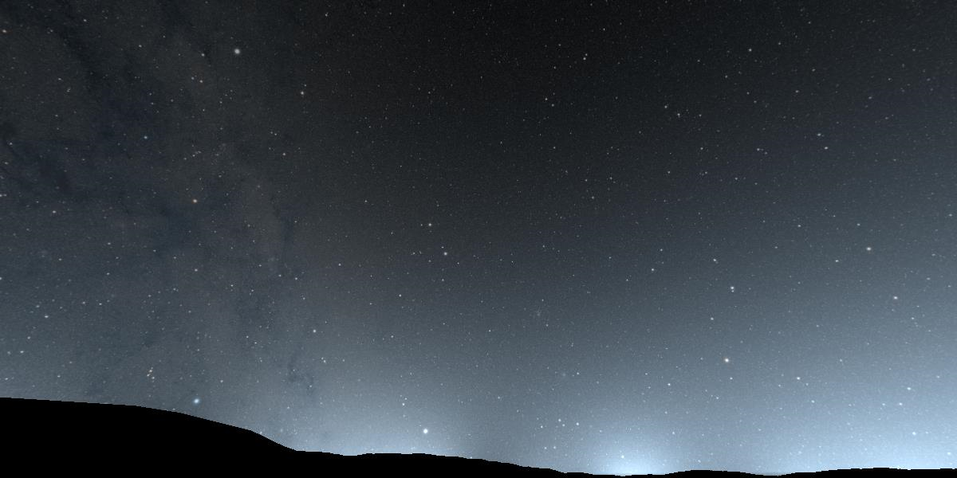
Overview
light source density
observer
terrain map (height field)
panorama
Notes:
Or a panorama image as viewed from the observer can also be provided as shown here.

Slide 14
Overview
light source density
forward rendering
inverse rendering
observer
terrain map (height field)
pseudo color
Notes:
And, in addition to the forward rendering our system also provides an inverse rendering function.

Slide 15
Overview
light source density
inverse rendering
observer
terrain map (height field)
pseudo color
Notes:
That is, our system can display the influence of each source to the light pollution with a pseudo color scheme as shown in this slide. This distribution is also computed in real-time.

Slide 16
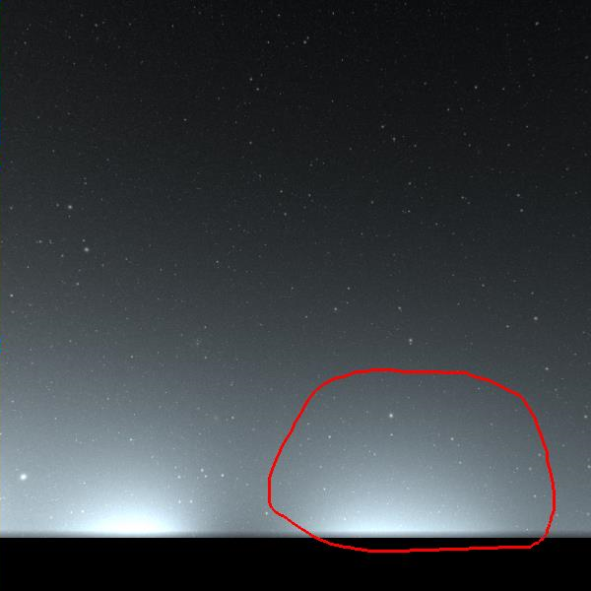
Overview
light source density
inverse rendering
observer
terrain map (height field)
perspective view

Slide 17
Features
Assumption
No occlusions by terrain
Precomputation-based approach
skyglow distributions with different light source positions
PCA to extract basis distributions
Forward rendering
linear combination of precomputed distributions
fast Fourier transform
Inverse investigation tools
light sources contributing to the total light pollution
light sources contributing to the skyglow in a rendered image
Notes:
Now let me summarize the overview of our method. Firstly, there are some assumptions in our method as shown at the top. Our method does not consider the occlusion by the terrain and the light from the light source is emitted uniformly in the upper hemisphere. Under these assumptions, our method achieves the fast rendering with a precomputation-based approach, where a set of skyglow distributions are precomputed and stored after applying the principal component analysis to obtain some basis distributions. Then, at runtime, the skyglow can be rendered efficiently with a linear combination of the precomputed basis distributions but we further significantly accelerate the computation by fast Fourier transform. This fast computation also allows us to provide the inverse investigation tool of the light pollution, as I mentioned in the previous slide. I would like to talk about our fast rendering method in the following slide.

Slide 18
Proposed Method
$$y$$
$$r_{c}$$
$$θ_{c}$$
$$x$$
observer
Notes:
Let me explain our method with the situation shown on the left. For computing the skyglow, we assume a local coordinate system where the origin is located at the observer location. Using this local coordinate system, we represent the density distribution of the light source as a function of polar coordinate, r_c and theta_c, as shown in the figure. The subscript 'c' indicates these variables are related to the city light distribution.

Slide 19
Proposed Method
$$y$$
viewing ray
$$(θ, φ)$$
$$u$$
$$e(θ,φ;r_{c})$$
$$L_{s}$$
$$r_{c}$$
$$x$$
$$z$$
observer
$$θ_{c}=0$$
$$y$$
$$φ$$
$$θ$$
$$r_{c}$$
$$x$$
unit intensity
Notes:
For a moment, let’s consider an infinitesimal light source with unit intensity located on the horizontal axis with the distance r_c. To compute the skyglow distribution due to this light source, we need to accumulate the scattered light on each viewing ray. The direction of the viewing ray is also represented with the polar coordinate, denoted as theta and phi as shown on the right, where phi in this case indicates the elevation angle.. Let’s denote the intensity of the scattered light by L_s. The intensity of light reaching the viewpoint, denoted by e, is then expressed by the equation shown in the next slide.

Slide 20
Proposed Method
$$e(θ,φ;r_{c})=\int{L_{s}\left(u\right)du}$$
viewing ray
$$(θ, φ)$$
$$u$$
$$e(θ,φ;r_{c})$$
$$L_{s}$$
PCA
$$z$$
$$y$$
$$φ$$
$$B_{k}(θ,φ)$$
$$θ$$
$$r_{c}$$
$$x$$
unit intensity
Notes:
That is, e is expressed as the sum of the scattered light L_s along the viewing ray. One of the keys to our fast computation is that we precompute a set of skyglow distributions by locating the infinitesimal light source at different distances from the observer, as shown in the slide. We then apply the principal component analysis to these distributions and obtain basis distributions. When we denote each basis distribution by Bk, function e is expressed by a weighted sum of the basis distributions, as shown by…

Slide 21
Proposed Method
$$e(θ,φ;r_{c})=\sum_{k}{c_{k}\left(r_{c}\right)B_{k}(θ,φ)}$$
viewing ray
$$(θ, φ)$$
$$u$$
$$e(θ,φ;r_{c})$$
$$L_{s}$$
PCA
$$z$$
$$y$$
$$φ$$
$$B_{k}(θ,φ)$$
$$θ$$
$$r_{c}$$
$$x$$
unit intensity
Notes:
this equation, where ck is a coefficient for each basis distribution.

Slide 22
Proposed Method
$$L_{c}(r_{c},θ_{c})$$
$$e(θ,φ;r_{c})=\sum_{k}{c_{k}\left(r_{c}\right)B_{k}(θ,φ)}$$
$$r_{c}$$
PCA
$$θ_{c}$$
observer
Notes:
Next, now let's go back to the computation of the skyglow considering the density distribution of light source over the terrain as shown on the right. In this case, we have to accumulate the contributions from all the light sources to compute the scattered light along the viewing ray.

Slide 23
Proposed Method
$$L_{c}(r_{c},θ_{c})$$
$$e(θ,φ;r_{c})=\sum_{k}{c_{k}\left(r_{c}\right)B_{k}(θ,φ)}$$
$$r_{c}$$
$$L_{s}(θ,φ)=\int_{0}^{R}{\int_{0}^{2π}{L_{c}(r_{c},θ_{c})r_{c}\left[\int_{u}{L_{s}\left(u\right)du}\right]dθ_{c}}dr_{c}}$$
$$θ_{c}$$
observer
accumulation over terrain
accumulation along viewing ray
Notes:
This can be expressed by this equation. This double integral part corresponds to the accumulation over the terrain and this single integral part to the accumulation along the viewing ray. To accelerate the computation..

Slide 24
Proposed Method
$$e(θ,φ;r_{c})=\sum_{k}{c_{k}\left(r_{c}\right)B_{k}(θ,φ)}$$
$$L_{s}(θ,φ)=\int_{0}^{R}{\int_{0}^{2π}{L_{c}(r_{c},θ_{c})r_{c}\left[\int_{u}{L_{s}\left(u\right)du}\right]dθ_{c}}dr_{c}}$$
accumulation over terrain
accumulation along viewing ray
Notes:
We put the precomputed distribution into this part.

Slide 25
Proposed Method
$$e(θ,φ;r_{c})=\sum_{k}{c_{k}\left(r_{c}\right)B_{k}(θ,φ)}$$
$$L_{s}(θ,φ)=\sum_{k}{\int_{0}^{R}{\int_{0}^{2π}{L_{c}\left(r_{c},θ_{c}\right)r_{c}c_{k}\left(r_{c}\right)B_{k}\left(θ−θ_{c},φ\right)dθ_{c}}dr_{c}}}$$
$$H_{k}(θ_{c})=\int_{0}^{R}{L_{c}(r_{c},θ_{c})c_{k}\left(r_{c}\right)r_{c}dr_{c}}$$
Notes:
And we obtain this equation. By this, the computation becomes faster since the accumulation along the viewing ray is replaced with the precomputed distribution. However, we still have the double integral, which is still time-consuming. If you look at this equation carefully, only this underlined part is related to the distance r_c. We introduce function H shown here, which is integral of the underlined part with respect to the distance.

Slide 26
Proposed Method
$$b(θ,φ;r_{c})=\sum_{k}{c_{k}\left(r_{c}\right)B_{k}(θ,φ)}$$
$$L_{s}(θ,φ)=\sum_{k}{\int_{0}^{2π}{H_{k}\left(θ_{c}\right)B_{k}(θ−θ_{c},φ) dθ_{c}}}$$
Notes:
By putting this function into the underlined part, we obtain this equation.

Slide 27
Proposed Method
$$L_{s}(θ,φ)=\sum_{k}{\int_{0}^{2π}{H_{k}\left(θ_{c}\right)B_{k}(θ−θ_{c},φ) dθ_{c}}}$$
Convolution
FFT for faster computation !
$$L_{s}\left(θ,φ\right)=\sum_{k}{ℱ^{−1}\left[ℱ\left[H_{k}\right]×ℱ\left[B_{k}\right]\right]}$$
$ℱ\left[⋅\right]$: Fourier Transform
runtime (fast)
Precomputation (slow)
Notes:
Now this is the equation we have to compute. If you look at this equation carefully, you might notice that this is the convolution between functions Hk and Bk. Both of these are periodic functions. We can use fast Fourier transform for faster computation. Finally, we use this equation to render the skyglow. The basis distribution and its Fourier transform is precomputed. Then, at runtime, we compute function H and its Fourier transform. The skyglow distribution is obtained by the inverse Fourier transform of the product of the two functions.

Slide 28
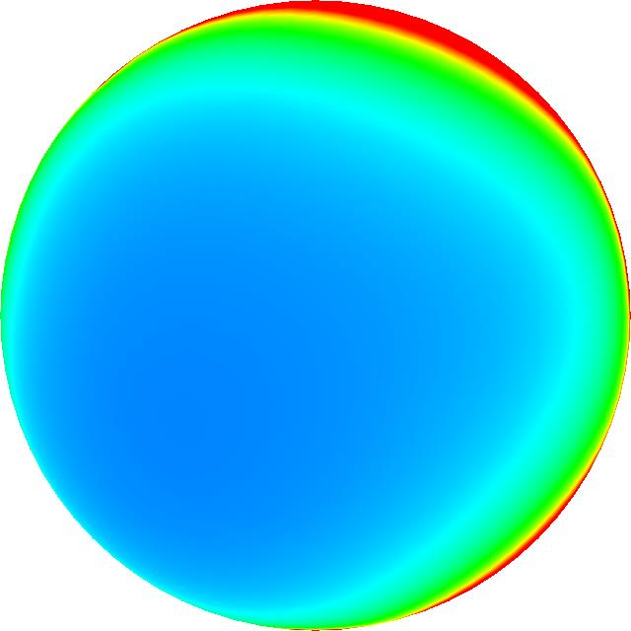
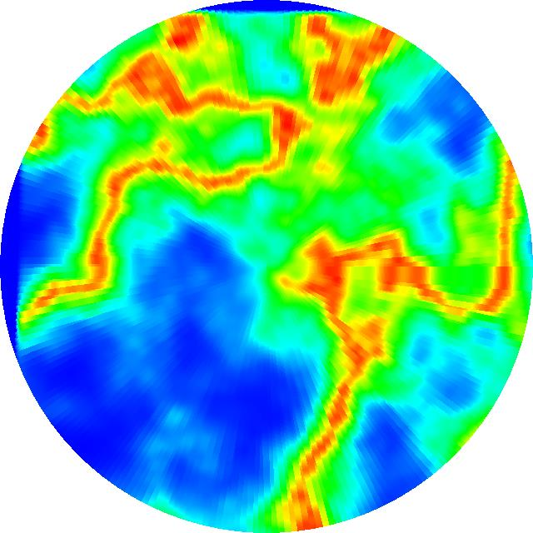
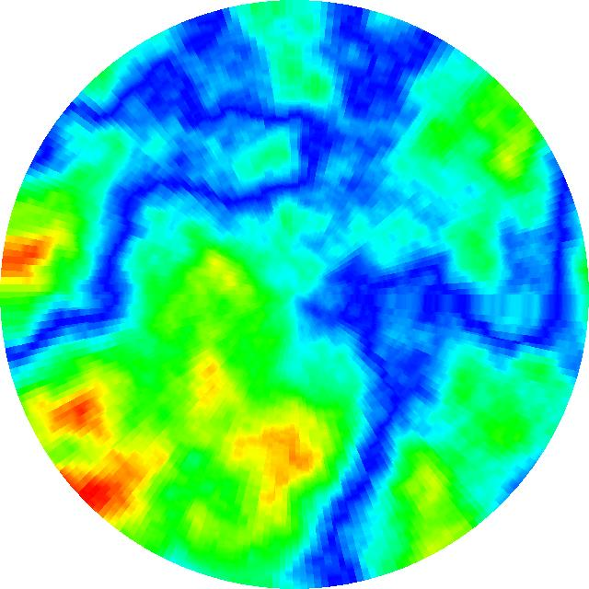
Implementation
preprocess
skyglow images $b$
coefficients $c_{k}$
basis images $B_{k}$
FFT of $B_{k}$
PCA
$$ℱ_{θ}$$
$$T_{c}$$
$$T_{\hat{B}}$$
$$ℱ_{θ}$$
$$ℱ_{θ}^{−1}$$
$$∗$$
$$T_{s}$$
$$T_{\hat{H}}$$
convolution
city light + altitude
city light $×$ coefficient
FFT of $H_{k}$
runtime process
$$L_{c}$$
$$h_{c}$$
$$H_{k}$$
See Figure 3 in the paper for the implementation details.
Notes:
Here is the illustration of the implementation details, but please refer to the paper for more details, but I would like to mention that all the computations are done of the GPU.

Slide 29
Extension to Inverse Investigation
Computing influence of each light source on light pollution
Two types of tools: total light pollution and visible skyglow
Making the most of the PCA-based representation
$$e(θ,φ;r_{c})=\sum_{k}{c_{k}\left(r_{c}\right)B_{k}(θ,φ)}$$
Inverse of Total of Light Pollution
Inverse of Visible Skyglow
Notes:
Next, I would like to briefly mention the extension to the inverse investigation tool. Our method can compute how each light source influences the light pollution. We developed two types of the tools. One is to investigate the influence of each light source on the total light pollution as shown on the left. In the second tool, the user can specify the skyglow region in the image as shown on the right, then our system computes the influence of each city light source on the skyglow inside the specified region. Our method is based on the pca-based representation of the skyglow to achieve the interactive investigation.

Slide 30
Inverse of Total Light Pollution
Subdivide terrain into a grid
Estimate influence of light at each grid cell with squared sum of the skyglow intensities over the whole sky
$$L_{c,i}$$
$$Q_{c,i}(r_{c})=\sqrt{\int_{Ω}{{\left|L_{c,i}e\left({ω;r}_{c}\right)\right|}^{2}dω}}$$
observer
$$e(ω;r_{c})=\sum_{k}{c_{k}\left(r_{c}\right)B_{k}(ω)}$$
Notes:
I first explain our inverse investigation method for the total light pollution. We first subdivide the terrain map into a regular grid as shown on the right and our method computes the influence of the cells with the positive density of light sources. Let's consider this orange lighting cell for example. We estimate the influence of this lighting cell on the light pollution at the observer location with the squared sum of the skyglow intensities over the whole sky, which is computed by this integral of the square of the product of the intensity of this lighting cell with the precomputed distribution b. Since we have represented function b with the pca basis functions as shown here,

Slide 31
Inverse of Total of Light Pollution
Subdivide terrain into a grid
Estimate contribution of light at each grid cell with squared sum of the skyglow intensities over the whole sky
$$L_{c,i}$$
$$Q_{c,i}(r_{c})=\sqrt{L_{c,i}\sum_{k}{c_{k}^{2}(r_{c})}}$$
observer
$$e(ω;r_{c})=\sum_{k}{c_{k}\left(r_{c}\right)B_{k}(ω)}$$
Notes:
The integral is replaced with the squared sum of the coefficients as shown by this equation.

Slide 32
Inverse of Total of Light Pollution
Subdivide terrain into a grid
Estimate contribution of light at each grid cell with squared sum of the skyglow intensities over the whole sky
$$L_{c,i}$$
$$Q_{c,i}(r_{c})=\sqrt{L_{c,i}\sum_{k}{c_{k}^{2}(r_{c})}}$$
observer
precompute
Notes:
We precompute this part when we apply the pca to the precomputed skyglow distributions in the preprocess, which makes it possible to evaluate influence function Q very efficiently for all the lighting cells.

Slide 33
Inverse of Total of Light Pollution
Subdivide terrain into a grid
Estimate contribution of light at each grid cell with squared sum of the skyglow intensities over the whole sky
$$Q_{c,i}(r_{c})=\sqrt{L_{c,i}\sum_{k}{c_{k}^{2}(r_{c})}}$$
observer
precompute
Notes:
The result is displayed with a pseudo color scheme as shown on the right. This influence distribution is updated in real-time even though we move the location of the observer. I will show you a demo later.

Slide 34
Inverse of Visible Skyglow
Specify the region on the sky dome with a closed curve.
Influence of each light source on the skyglow inside the curve.
$$s_{p,i}(ω_{p};r_{c})=L_{c,i}e(ω_{p};r_{c})$$
$$L_{c,i}$$
specified curve
$$p$$
observer
Notes:
Next, I would like to explain another tool for inverse investigation. In this tool, the user can draw a closed curve as shown on the right. Then our system computes the influence of each lighting cell on the skyglow inside the specified curve. Let's again consider this orange lighting cell. The influence of this cell to pixel p inside the curve can be computed by the product of the intensity of this cell and the precomputed distribution b.

Slide 35
Inverse of Visible Skyglow
Specify the region on the sky dome with a closed curve.
Influence of each light source on the skyglow inside the curve.
$$s_{p,i}(ω_{p};r_{c})=L_{c,i}e(ω_{p};r_{c})$$
$$L_{c,i}$$
specified curve
$$S_{i}=\sum_{p}{s_{p,i}(ω_{p};r_{c})}$$
$$p$$
observer
Notes:
Then, the influence of this lighting cell on all the pixels inside the curve is simply obtained by accumulating it over the pixels inside the curve.

Slide 36
Inverse of Visible Skyglow
Specify the region on the sky dome with a closed curve.
Influence of each light source on the skyglow inside the curve.
$$s_{p,i}(ω_{p};r_{c})=L_{c,i}e(ω_{p};r_{c})$$
specified curve
$$S_{i}=\sum_{p}{s_{p,i}(ω_{p};r_{c})}$$
$$p$$
observer
Notes:
The result is displayed with the pseudo color scheme, as shown in the slide.

Slide 37
Results
Computer
CPU: Intel Corei9 3.00 GHz, 128GB Memory
GPU: NVIDIA Quadro RTX6000, 24 GB Memory
Experimented with a synthetic terrain model (10km x 10km x 1km)
Resolution for the skyglow distribution: 256 x 64
OpenGL + GLSL
Notes:
OK, let me show you some results. We implemented our method on this computer and all the computations are done in parallel on the GPU, as I said.

Slide 38
Performance Evaluation
Single scattering only, no occlusion
2048 lighting cells
256 basis functions for our method
Reference
Method | Precomp. | Runtime | Errors
Reference | N/A | 2117 ms | N/A
Our | 4 hours | 2.3 ms | 0.38 %
Ours
10%
920 times faster !
0%
Relative error
Notes:
First, I would like to show some results for the performance evaluation. This slide shows the results with the single scattering computation. The terrain is represented with a 1k times 1k grid and there are 2,048 lighting cells. We use 256 pca basis for our method. Here are comparison of images with the reference solution and our method. The reference image is rendered by casting a ray for each pixel and by accumulating the scattered light on the viewing ray. We use the GPU for both the reference and our methods. The occlusion by the terrain is not considered for both methods. The image on the bottom show the relative error between these two images. The tow images are almost the same meaning our method is very accurate. This table shows the statistics of the performance. In this case, the precomputation took four hours, but our method achieves 920 times faster rendering speed.

Slide 39
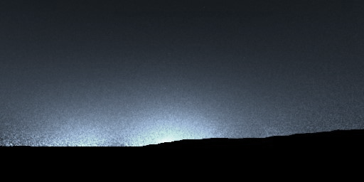
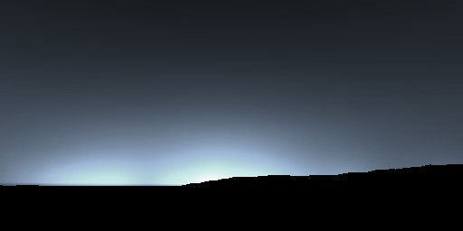
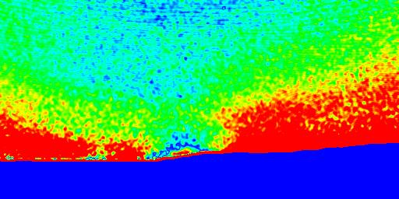
Performance Evaluation
Multiple scattering + occlusion
2048 lighting cells
32 basis functions for our method
Reference
Method | Precomp. | Runtime | Errors
Reference | N/A | 130 sec | N/A
Our | 38 hours | 2.1 ms | 13 %
Ours
20%
62,000 times faster !
0
Relative error
Notes:
Next, we compare our results with those obtained by a physically-based path tracer. We used Mitsuba3 for this comparison. We take into account the multiple scattering to compute our basis distributions. The number of basis functions is 32. The results are shown on the right. The top image is rendered with the path tracer. Please note that the occlusion by terrain is taken into account for the reference, but our method does not. In this case the error becomes larger as shown at the bottom, but the appearance of the sky is very similar. The performance comparison is summarized in this table. When using the path tracer, it took 130 seconds to render the reference image. Our method requires only 2 milliseconds. Thus, our method achieves sixty-two thousands faster computation. Moreover, if you look at the images carefully, the reference image still has some noises but our result does not.

Slide 40
Notes:
OK, I would like to show you a video demonstrating the ability of our method.

Slide 41
Notes:
OK, I would like to show you a video demonstrating the ability of our method.

Slide 42
Conclusions & Future Work
We have achieved:
three orders magnitudes faster rendering speed
forward and inverse investigation tool
We want to address:
extension to occlusion by terrain
inverse design of lighting devices
light distribution curve and spectral distribution
Notes:
Finally, let me conclude this presentation. We have proposed an efficient visualization system for light pollution for the night sky. We have achieved three orders of magnitudes faster computation and we have proposed the interactive forward and inverse investigation tool. However, there still has many things that we want to address in the future. Firstly, we need to extend our method to occlusion by terrain for more accurate visualization. We also need to take into account the light distribution curve of the light sources to allow us to inversely design the lighting devices that can reduce the light pollution.
That's it. Thank you for your attention!

